Slide 1

Git
Hands on Keyboard
Roman Bosák
Tieto,
roman.bosak@tieto.com

Slide 2
Who am I?
VŠB FEI absolvent (1996-2002)
~15 years in software development (Java)
10 years in Tieto
Developer
Configuration manager
Team leader
Scrum master
Architect
Mentor / Trainer / Coach

Slide 3
Who is Git?
Git is an open source, distributed version control system designed for speed and efficiency

Slide 4
Git is an open source, distributed version control system designed for speed and efficiency

Slide 5
Version Control System (VCS)
Record history
Facilitate team work
Expose source code
Branch/merge development paths

Slide 6
Version Control System (VCS)
Mercurial (hg)
Bazaar
Subversion (SVN)
Concurrent Version System (CVS)
Perforce
Visual Source Safe

Slide 7
Version Control System (VCS)
Mercurial (hg)
Bazaar
Subversion (SVN)
Concurrent Version System (CVS)
Perforce
Visual Source Safe
„not bad“

Slide 8
Version Control System (VCS)
Mercurial (hg)
Bazaar
Subversion (SVN)
Concurrent Version System (CVS)
Perforce
Visual Source Safe
„not bad“
„kill self“

Slide 9
Version Control System (VCS)
Git
Mercurial (hg)
Bazaar
Subversion (SVN)
Concurrent Version System (CVS)
Perforce
Visual Source Safe
„not bad“
„kill self“

Slide 10
Git History
Linus Torvalds needed a replacement for BitKeeper to maintain the Linux kernel
First prototype on April 7, 2005
Why Git?
(British, slang, pejorative) A silly, incompetent, stupid, annoying or childish person.
Linus: „I‘am an egoistical bastard, and I name all my projects after myself. First Linux, now git.“
Alternatively: „Global Information Tracker“

Slide 11
Git is an open source, distributed version control system designed for speed and efficiency

Slide 12
Centralized VCS
Master
Repository
permissions branches
commit
checkout
update
Working copy
Working copy
Working copy
Copies
Alice
Bob
Charlie

Slide 13
Typical open source schema
Remote
(public/private)
Repository
Repository
Repository
„Alice“
„public read“
„Charlie“
push
fetch
Local
Repository
Repository
Repository
commit
checkout
Working copy
Working copy
Working copy
Alice
Bob
Charlie

Slide 14
Distributed
(almost) everything is local
which means
work offline
everything is fast
every clone is a backup

Slide 15
No Network Needed
Performing a diff
Viewing file history
Committing changes
Merging branches
Obtaining any other revision of a file
Switching branches

Slide 16
Distributed VCS Flow
Working copy
Bob

Slide 17
Distributed VCS Flow
Local
Repository
init commit
Working copy
Bob

Slide 18
Distributed VCS Flow
Remote
(public/private)
Repository
„public read“
push
Local
Repository
Working copy
Bob

Slide 19
Distributed VCS Flow
Remote
(public/private)
Repository
„public read“
clone
clone
Local
Repository
Repository
Repository
Working copy
Alice
Bob
Charlie

Slide 20
Distributed VCS Flow
Remote
(public/private)
Repository
„public read“
Local
Repository
Repository
Repository
checkout
checkout
Working copy
Working copy
Working copy
Alice
Bob
Charlie

Slide 21
Distributed VCS Flow
Remote
(public/private)
Repository
„public read“
Local
Repository
Repository
Repository
commit
commit
commit
Working copy
Working copy
Working copy
Alice
Bob
Charlie

Slide 22
Distributed VCS Flow
Remote
(public/private)
Repository
Repository
Repository
„Alice“
„public read“
„Charlie“
push
push
Local
Repository
Repository
Repository
Working copy
Working copy
Working copy
Alice
Bob
Charlie

Slide 23
Distributed VCS Flow
Remote
(public/private)
Repository
Repository
Repository
„Alice“
„public read“
„Charlie“
add remote fetch
add remote fetch
Local
Repository
Repository
Repository
Working copy
Working copy
Working copy
Alice
Bob
Charlie

Slide 24
Distributed VCS Flow
Remote
(public/private)
Repository
Repository
Repository
„Alice“
„public read“
„Charlie“
Local
Repository
Repository
Repository
merge alice master merge charlie master
Working copy
Working copy
Working copy
Alice
Bob
Charlie

Slide 25
Distributed VCS Flow
Remote
(public/private)
Repository
Repository
Repository
„Alice“
„public read“
„Charlie“
push
Local
Repository
Repository
Repository
Working copy
Working copy
Working copy
Alice
Bob
Charlie

Slide 26
Terminology
Repository
contains the history, the different versions over time and all different branches and tags
in Git each copy of the repository is a complete repository
Working copy
contains the content of a commit which you can checkout from the Git repository, modify and commit the changes
Branch
separate code line with its own history
Master
main branch
Tag
points to a commit which uniquely identifies a version of the Git repository
Revision
represents a version of the source code
Head
last revision within given branch

Slide 27
Repository addressing
addressed by URI
Repository can have multiple references to other repositories (remotes)
To simplify addressing aliases are used
To configure remotes ‘remote’ command is used
‘origin’ is default alias

Slide 28
Understanding Git
Command line

Slide 29
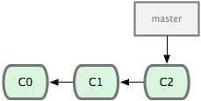
Git flow - branches
$ git log
$ git status

Slide 30
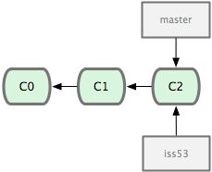
Git flow - branches
$ git branch iss53
$ git checkout iss53
Or shortly
$ git checkout -b iss53
Switched to a new branch "iss53"

Slide 31
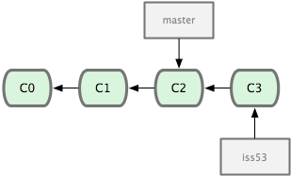
Git flow - branches
$ vim index.html
$ git commit -a -m 'added a new footer in progress [issue 53]'

Slide 32
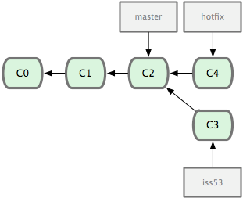
Git flow - branches
$ git checkout master
Switched to branch "master“
$ git checkout -b hotfix
Switched to a new branch "hotfix"
$ vim index.html
$ git commit -a -m 'fixed the broken email address'
[hotfix]: created 3a0874c: "fixed the broken email address"
1 files changed, 0 insertions(+), 1 deletions(-)

Slide 33
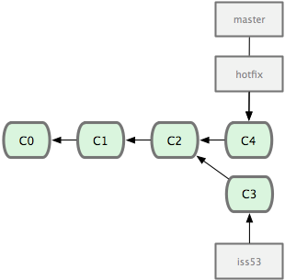
Git flow - branches
$ git checkout master
$ git merge hotfix
Updating f42c576..3a0874c
Fast forward
README | 1 -
1 files changed, 0 insertions(+), 1 deletions(-)

Slide 34
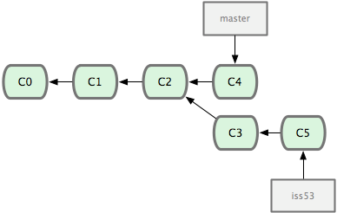
Git flow - branches
$ git checkout iss53
Switched to branch "iss53"
$ vim index.html
$ git commit -a -m 'finished the new footer [issue 53]'
[iss53]: created ad82d7a: "finished the new footer [issue 53]"
1 files changed, 1 insertions(+), 0 deletions(-)

Slide 35
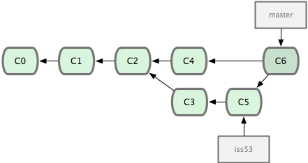
Git flow - branches
$ git checkout master
$ git merge iss53
Merge made by recursive.
README | 1 +
1 files changed, 1 insertions(+), 0 deletions(-)

Slide 36
HANDS ON KEYBOARD
Git GUI and Gitk

Slide 37
Git Usage
Command line
Git Gui
Gitk

Slide 38
Tools Installation
Git
http://git-scm.com/
KDiff3
http://kdiff3.sourceforge.net/
GitHub
https://github.com/
https://github.com/TEGitTrainings/TEGitTraining201506 (https://goo.gl/hZlx5O)

Slide 39
Configuration
Everything is file
Three levels
System
Global (user)
Repository
git config
Important parameters
user.name
user.email
core.autocrlf
alias
gitignore
gitmodules
gitattributes
git config --global user.name "Roman Bosak"
git config --global user.email "roman.bosak@gmail.com"

Slide 40
Git Flow – first commits
Remote
Repository
„shared“

Slide 41
Git Flow – first commits
Remote
Repository
„shared“
clone
clone
clone
Local
Repository
Repository
Repository
checkout
checkout
checkout
Working copy
Working copy
Working copy
Alice
Bob
Charlie
Notes:
$ git clone git@mqxgit.ea.freescale.net:gitorious-test-project/mqx-small-test-repo.git gitintrotest
Cloning into 'gitintrotest'...
remote: Counting objects: 5159, done.
remote: Compressing objects: 100% (1891/1891), done.
remote: Total 5159 (delta 3211), reused 5159 (delta 3211)
Receiving objects: 100% (5159/5159), 7.42 MiB | 538 KiB/s, done.
Resolving deltas: 100% (3211/3211), done.
$ git log
commit 8a0a9b0b84ad0aab72fc9bbd37a5b1cfc9888588
Author: Vladimir Vanek (B35211) <vladimir.vanek@freescale.com>
Date: Sun Jan 6 11:21:36 2013 +0100
initial commit

Slide 42
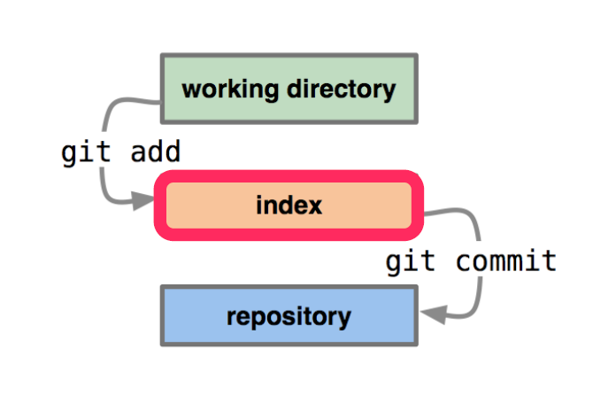
Git Flow – first commits
Remote
Repository
„shared“
Local
Repository
Repository
Repository
commit
Working copy
Working copy
Working copy
Alice
Bob
Charlie

Slide 43
Git Flow – first commits
Remote
Repository
„shared“
push
Local
Repository
Repository
Repository
Working copy
Working copy
Working copy
Alice
Bob
Charlie

Slide 44
Git Flow – first commits
Remote
Repository
„shared“
pull
pull
Local
Repository
Repository
Repository
Working copy
Working copy
Working copy
Alice
Bob
Charlie

Slide 45
Git Flow – first commits
Remote
Repository
„shared“
Local
Repository
Repository
Repository
commit
commit
Working copy
Working copy
Working copy
Alice
Bob
Charlie

Slide 46
Git Flow – first commits
Remote
Repository
„shared“
push
Local
Repository
Repository
Repository
Working copy
Working copy
Working copy
Alice
Bob
Charlie

Slide 47
Git Flow – first commits
Remote
Repository
Fail
„shared“
push
Local
Repository
Repository
Repository
Working copy
Working copy
Working copy
Alice
Bob
Charlie

Slide 48
Git Flow – first commits
Remote
Repository
„shared“
pull
Local
Repository
Repository
Repository
Working copy
Working copy
Working copy
Alice
Bob
Charlie

Slide 49
Git Flow – first commits
Remote
Repository
„shared“
push
Local
Repository
Repository
Repository
Working copy
Working copy
Working copy
Alice
Bob
Charlie

Slide 50
Git Flow – first commits
Remote
Repository
„shared“
Local
Repository
Repository
Repository
branch
commit
Working copy
Working copy
Working copy
Alice
Bob
Charlie

Slide 51
Git Flow – first commits
Remote
Repository
„shared“
push
Local
Repository
Repository
Repository
Working copy
Working copy
Working copy
Alice
Bob
Charlie

Slide 52
Actions / commands summary
Clone
Add / rm (stage / unstage)
Commit
Push
Fetch
Checkout
Pull
Remote
Status
Log
Reset

Slide 53
GIT INTERNALS
Command line

Slide 54
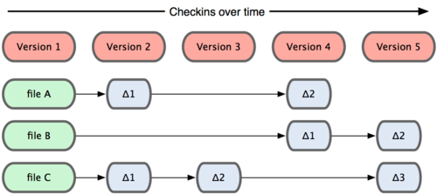
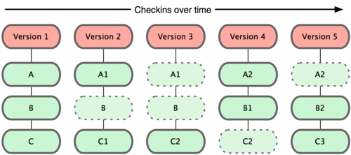
Standard VCS vs. Git
Standard VCS
Stores deltas
Git
Set of snapshots
if files have not changed, Git doesn’t store the file again – just a link

Slide 55
Git internals
Everything stored within .git folder as files
Objects
Blob
a bunch of bytes that could be anything, like a text file, source code, or a picture, etc.
identified by 20 byte sha1 “hash” of the file contents
metadata (file name)
Tree
like a filesystem directory. A git tree can point to, or include Git blobs and other Git trees
identified by hash
Commit
a pointer to the git tree object that represents the git repository when the commit was done
metadata (name and email address of the one who commited, time, …)
the parent commit to this commit
Tag
points to any git commit object
Metadata (name of the tag, tag message, The tagger’s name, email address and the time the tag was added)

Slide 56
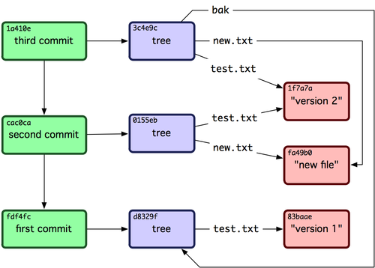
Git internals
First commit
git_example/
test.txt [v1]
Second commit
git_example/
test.txt [v2]
new.txt
Third commit
git_example/
bak/
test.txt [v1]
test.txt [v2]
new.txt

Slide 57
Commit addressing
addressed by hash
The SHA-1 digest is 20 bytes or 160 bits. The number of randomly hashed objects needed to ensure a 50% probability of a single collision is about 2^80 (the formula for determining collision probability is p = (n(n-1)/2) * (1/2^160)). 2^80 is 1.2 x 10^24 or 1 million billion billion. That’s 1,200 times the number of grains of sand on the earth.
If all 6.5 billion humans on Earth were programming, and every second, each one was producing code that was the equivalent of the entire Linux kernel history (1 million Git objects) and pushing it into one enormous Git repository, it would take 5 years until that repository contained enough objects to have a 50% probability of a single SHA-1 object collision. A higher probability exists that every member of your programming team will be attacked and killed by wolves in unrelated incidents on the same night.
4 to 6 first characters are usually enough
to simplify “refs” (references) are used
Branches
Tags
HEAD

Slide 58
Git tools - advanced usage
Hunk / Line staging
Conflict resolution
Browsing history
Views
Diffs
Search / Highlight
Blame

Slide 59
Additional Git Features
Tagging
Stash
Line / Hunk Commit
Revert
Ammend Commit (never ammend public commits)
Squash
Force push
Cherry Pick
Rebase
Jira integration
Eclipse integration

Slide 60
Good to know
Delete remote branch
git push origin :<branchName>
or in case there is a tag with same name git push origin :refs/heads/<branchName>
Delete tag (local and remote)
git tag -d <tagName>
git push origin :<tagName>
or in case there is a branch with same name git push origin :refs/tags/<tagName>

Slide 61
Good to know
Restore lost commits
Commit is never lost (unless you have used git gc)
git fsck --lost-found [... some blobs omitted ...] dangling commit 7c61179cbe51c050c5520b4399f7b14eec943754
git reflog 39ba87b... HEAD@{0}: HEAD~1: updating HEAD 7c61179... HEAD@{1}: pull origin master: Fast forward [... lots of other refs ...]
git merge 7c61179

Slide 62
Git is an open source, distributed version control system designed for speed and efficiency

Slide 63
Performance test
Parameters: MQX src content (MQX 3_7_REL0)
 | GIT | CC | AccuRev 5.5 (timestamp optimization off)
 |  | (incl. proj.)
Create workspace | By Clone 10 m | N/A | N/A
 | By Checkout 1 m | 1 h | 10 m
Update (no changes) | < 1 m | 1 h | 1 m
Show changes between EAR1–EAR4 (6500 files): | 1 m | 1 h | 1 m
Merge (10 files trivial merge) | 1 m | Not tested | Not tested
Check-in / Commit / Push / Promote (10 files) | 1 m | Not tested | 8-10 m

Slide 64
Git Hosting
https://github.com/
Free public
Paid private
http://gitorious.org/
Paid
http://code.google.com
Free public
Also Mercurial and SVN
https://bitbucket.org/
Free unlimited private repos for 5 users
Bigger plans are paid
Dropbox is possibility and any other shared folder is possibility as well

Slide 65
Questions?

Slide 66
Thank You
Roman Bosák
Ing.
Tieto,
roman.bosak@tieto.com

Slide 67
GIT repositories
git@mqxgit.ea.freescale.net:gitorious-test-project/mqx-small-test-repo.git
\\zcz01-0172\GIT.test.rep\mqx-small-test-repo\

